Slide 1

ECE 530 Cloud Computing
Ioannis Papapanagiotou
Long term storage

Slide 2
Object Storage
Redundant, scalable object storage using clusters of standardized servers capable of storing petabytes of data
Object Storage is not a traditional file system, but rather a distributed storage system for static data such as virtual machine images, photo storage, email storage, backups and archives.
Having no central "brain" or master point of control provides greater scalability, redundancy and durability.

Slide 3
Object Storage Durability
Objects and files are written to multiple disk drives spread throughout servers in the data center,
IaaS software responsible for ensuring data replication and integrity across the cluster.
Storage clusters scale horizontally simply by adding new servers.
Should a server or hard drive fail, IaaS vendor replicates its content from other active nodes to new locations in the cluster
IaaS vendors use software logic to ensure data replication and distribution across different devices, inexpensive commodity hard drives and servers can be used in lieu of more expensive equipment.
99.999999999% durable, and scale past tens of trillions of objects.

Slide 4
Block vs Object

Slide 5
Storage Decision
 | Ephemeral storage | Block storage | Object storage
Used to… | Run operating system and scratch space | Add additional persistent storage to a virtual machine (VM) | Store data, including VM images
Accessed through… | A file system | A block device that can be partitioned, formatted, and mounted (such as, /dev/vdc) | REST API/Vendor specific API
Accessible from… | Within a VM | Within a VM | Anywhere
Persists until… | VM is terminated | Deleted by user | Deleted by user
Sizing determined by… | Administrator configures size settings, known as flavors | Specified by user in initial request | Amount of available physical storage
Example of typical usage… | Up to 1TB | several TBs or for instances without Ephemeral storae | 10s of TBs of dataset storage

Slide 6
AWS S3 Storage Classes
S3 Standard
S3 Intelligent-Tiering
S3 Standard-Infrequent Access (S3 Standard-IA)
S3 One Zone-Infrequent Access (S3 One Zone-IA)
Amazon S3 Glacier (S3 Glacier)
Amazon S3 Glacier Deep Archive (S3 Glacier Deep Archive).

Slide 7
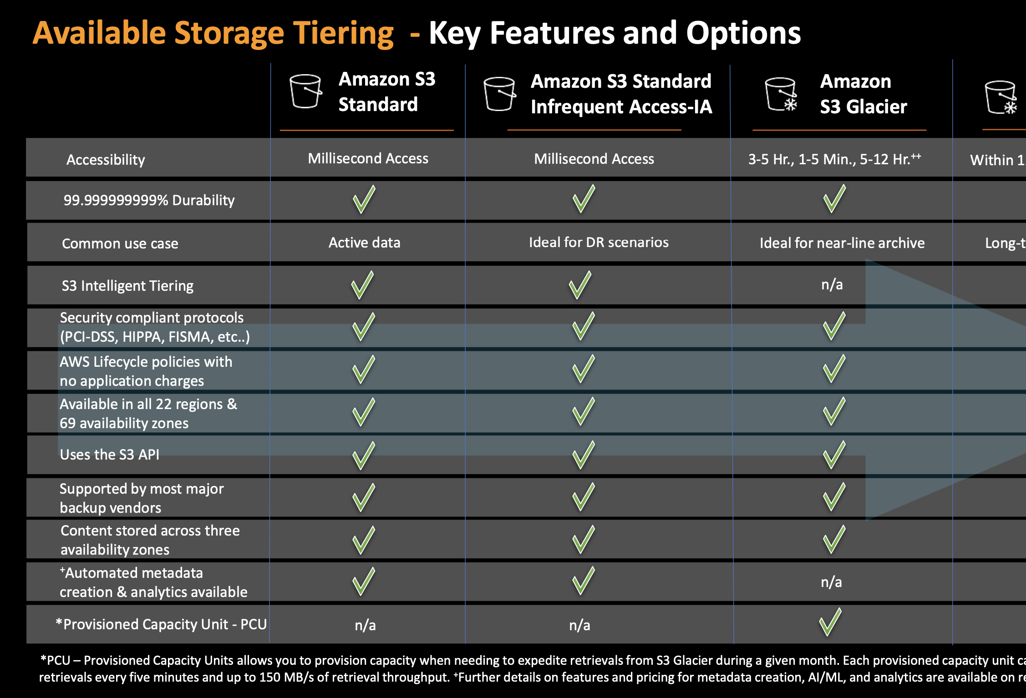

Slide 8
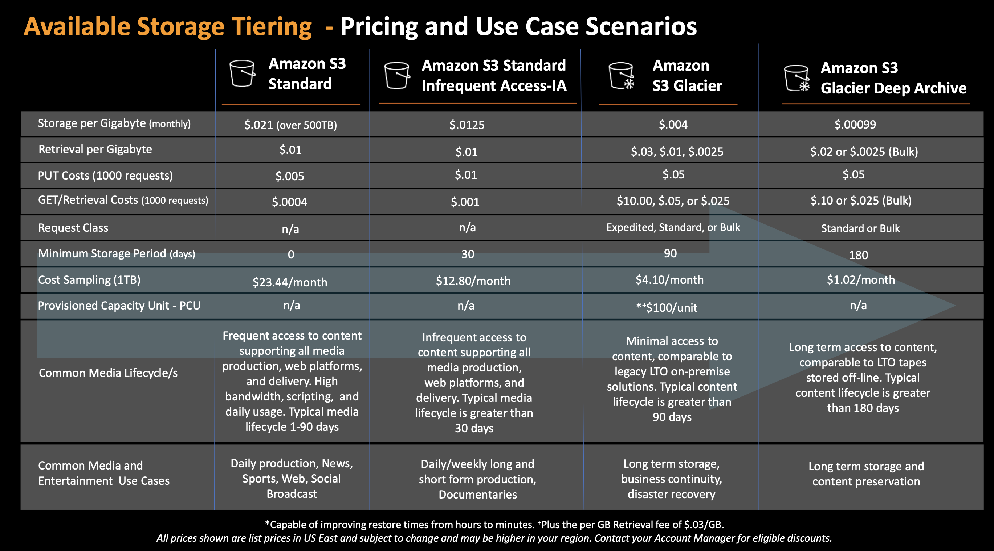

Slide 9
Data Archiving
IaaS provide a secure, durable, and extremely low-cost cloud storage service for data archiving and long-term backup.
Customers can reliably store large or small amounts of data for less than 1 center per gigabyte per month,
a significant savings compared to on-premises solutions.
To keep costs low, data archiving technologies are optimized for infrequently accessed data where a retrieval time of several hours is suitable.
Can be very useful to decrease the cost of storing data to S3 by moving the infrequent data to data archiving.

Slide 10
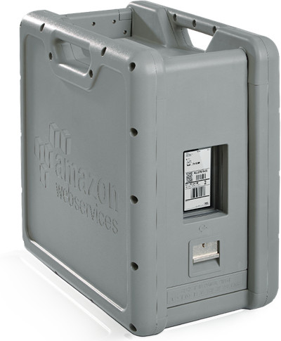
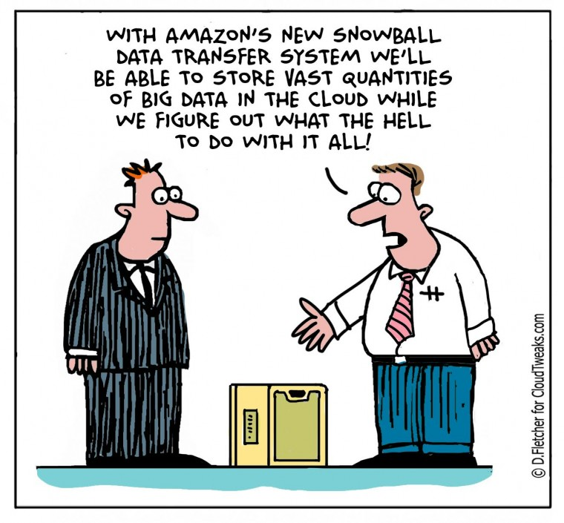
Huge Data Transfer
Transferring terabytes or petabytes of data from an existing data center to the cloud remains challenging.
All-in move to the cloud presents some surprising issues.
decommission existing data centers after they move their apps and their data; in such a situation, upgrading their last-generation networking gear and boosting connection speeds makes little or no sense.

Slide 11
Vendor offerings
Block storage
OpenStack: Cinder
AWS: Elastic Block Storage (EBS)
Object storage
OpenStack: Swift
AWS: S3
Azure: Blob Storage
Google: Cloud Storage
Data Archiving
AWS: Glacier
Huge Data Transfer
AWS: Snowball
Azure: Import/Export

